Slide 1
BERT最新变体
报告人：黎芮彤

Slide 2
论文报告
ACL2020：FastBERT: a Self-distilling BERT with Adaptive Inference Time
Weijie Liu, Peng Zhou, Zhe Zhao, Zhiruo Wang, Haotang Deng and Qi Ju
Peking University, Tencent Research
报告人：黎芮彤

Slide 3
背景
做大做深
1.GPT2
2. XLNet (Yang et al., 2019)
3.Megatron-LM
4.DeepSpeed
BERT (Devlin et al., 2019)
1.quantinization (Gong et al., 2014),
2.knowledge distillation (KD)(Romero et al., 2014)
3.LayerDrop
剪枝，蒸馏

Slide 4
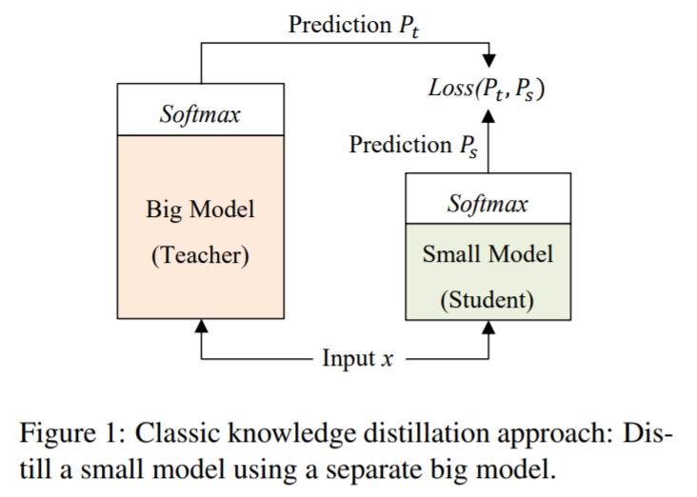
创新点
• 一种特殊的Bert模型---FastBERT
• 一种自适应的自蒸馏机制

Slide 5
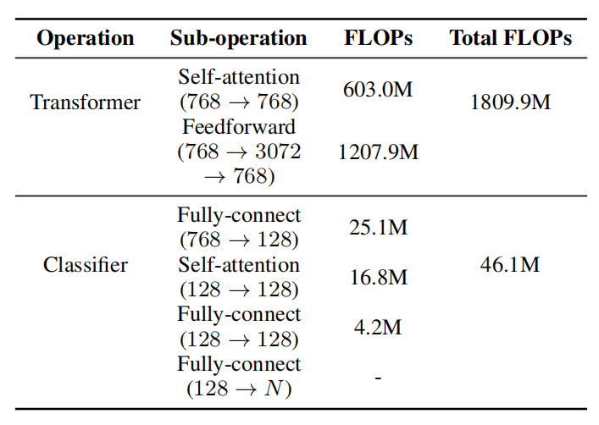
FLOPs of each operation within the FastBERT

Slide 6
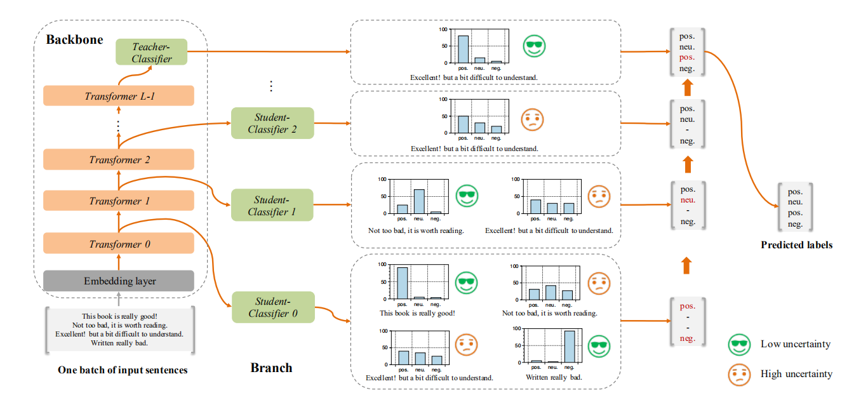
The inference process of FastBERT

Slide 7
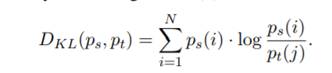
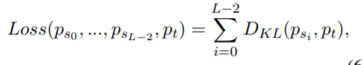
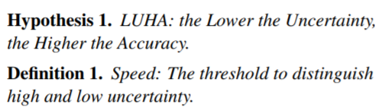
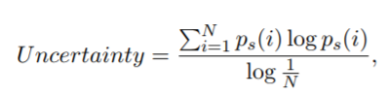
训练方法
1.Pre-training：和BERT一样；
2.Fine-tuning for Backbone：加入老师分类器，加入训练数据；
3.Self-distillation for branch：学生分类器蒸馏，无标签任务数据；
4.Adaptive inference：自适应推理，根据不确定性过滤样本。

Slide 8
Baseline and dataset
Baseline
BERT： The 12-layer BERT-base model was pre-trained on Wiki corpus and released by Google (Devlin et al., 2019).
DistilBERT： The most famous distillation method of BERT with 6 layers was released by Huggingface (Sanh et al., 2019).
Dataset
The six Chinese datasets：ChnSentiCorp,Book review, Shopping reviews, Weibo and THUCNews,LCQMC
The six English datasets：Ag.News, Amz.F, DBpedia,Yahoo, Yelp.F, and Yelp.P

Slide 9
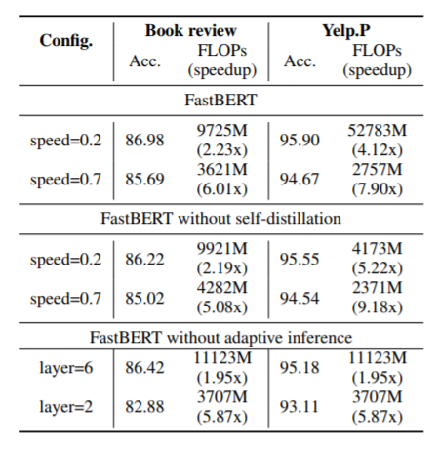
Results of ablation studies on the Book review
and Yelp.P datasets.

Slide 10
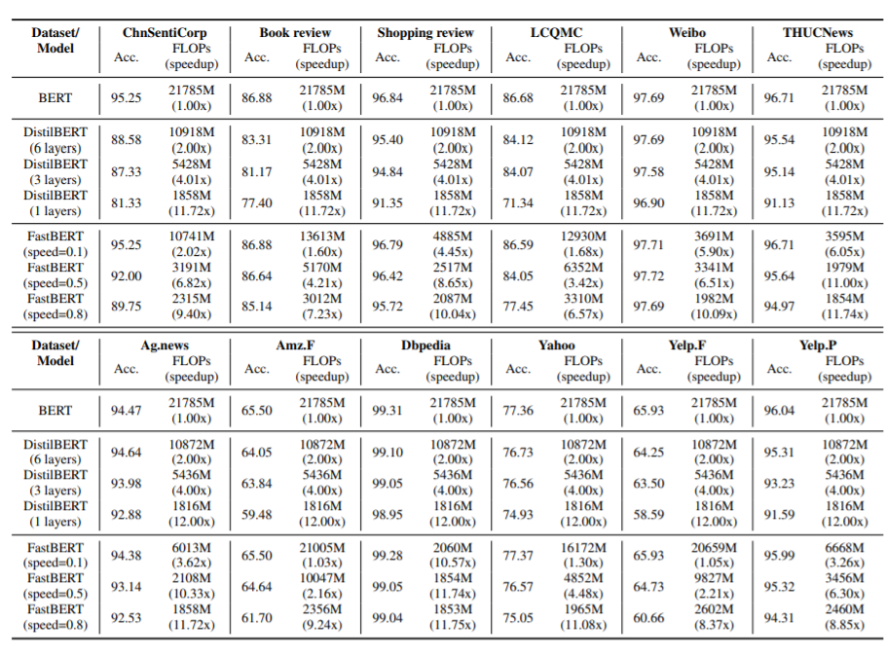
Comparison of accuracy (Acc.) and FLOPs (speedup)

Slide 11
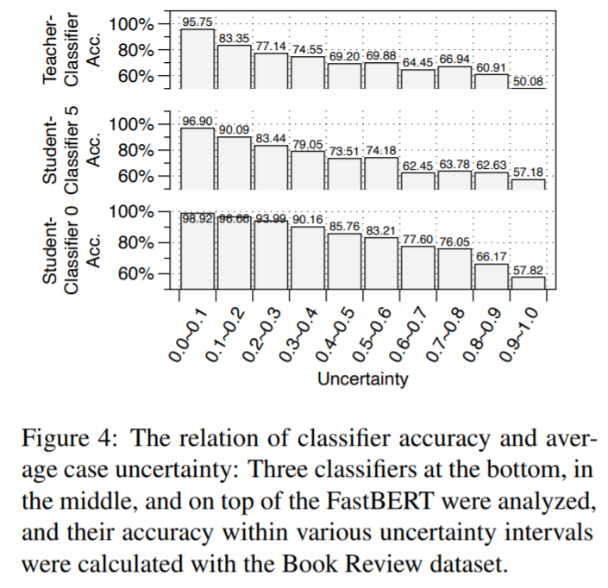
LUHA hypothesis verification

Slide 12
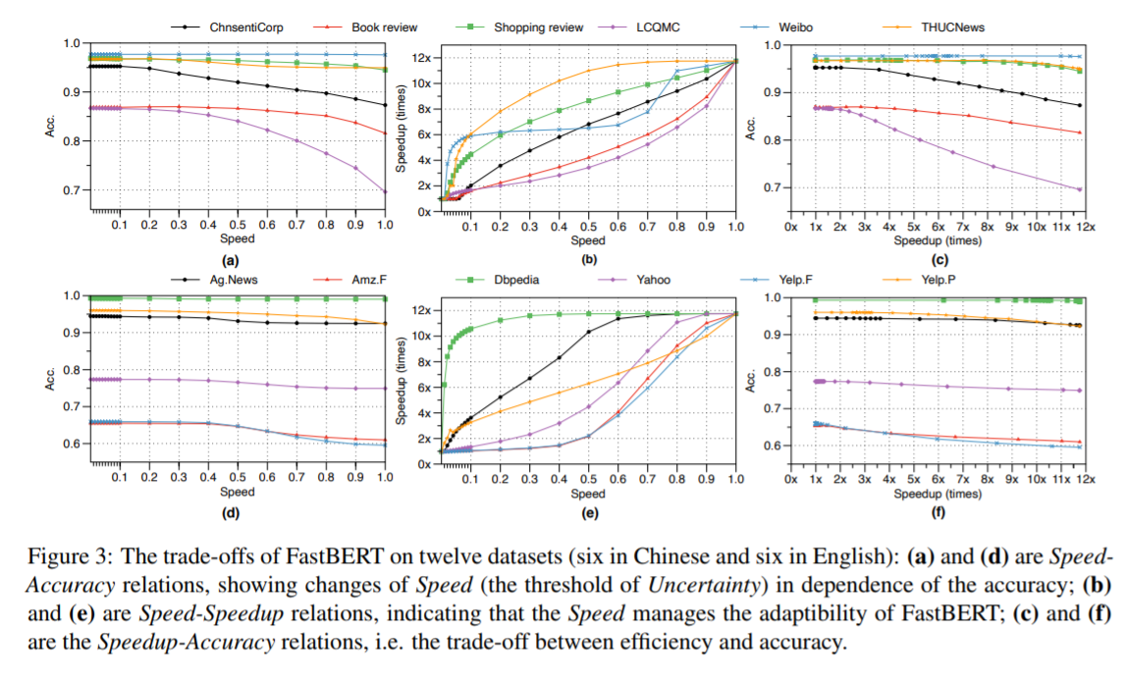
Performance comparison

Slide 13
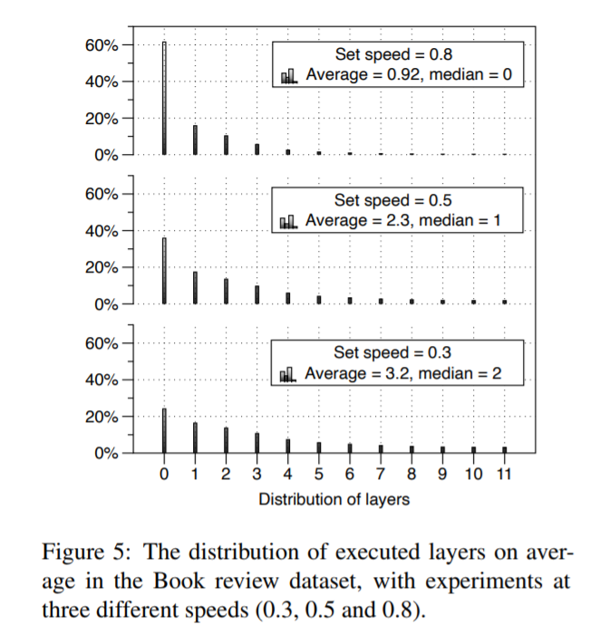
Layer distribution

Slide 14
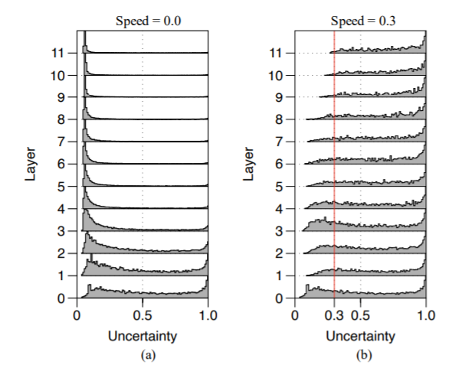
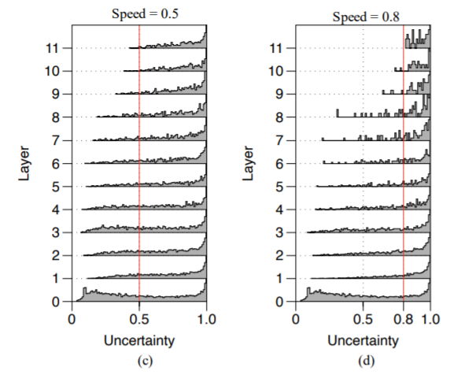
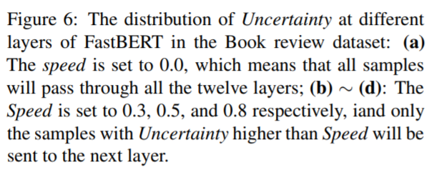
Uncertainty distribution

Slide 15
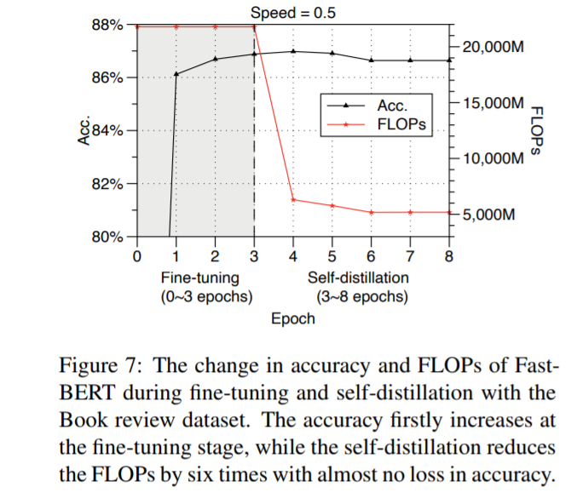
Convergence of self-distillation

Slide 16
论文报告
K-BERT: Enabling Language Representation with Knowledge
Weijie Liu, Peng Zhou, Zhe Zhao, Zhiruo Wang, Haotang Deng and Qi Ju
Peking University, Tencent Research
报告人：黎芮彤

Slide 17
创新点
(1) Heterogeneous Embedding Space (HES)
(2) Knowledge Noise (KN)
挑战：
（1）knowledge-enabled LR model, namely K-BERT
（2）它与BERT兼容，可以纳入没有HES和KN问题的域知识
解决：

Slide 18
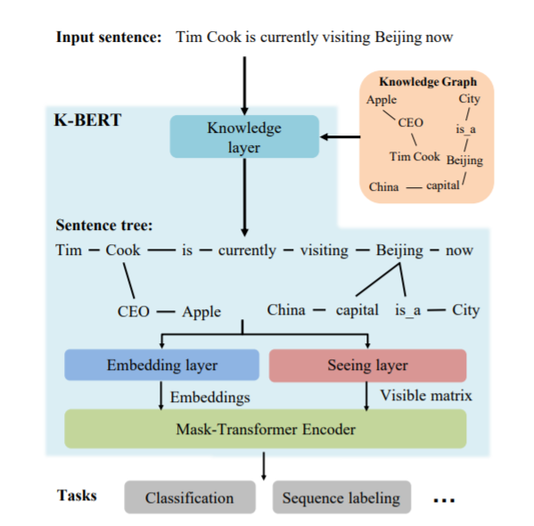
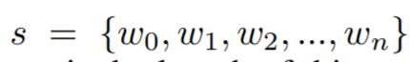
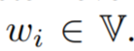
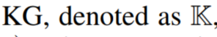
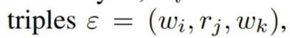
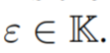
The model structure of K-BERT

Slide 19
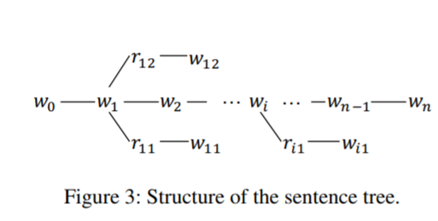
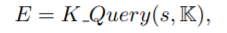
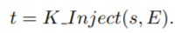
Knowledge layer（KL）
知识查询（K-Query）：
知识注入（K-Inject）：

Slide 20
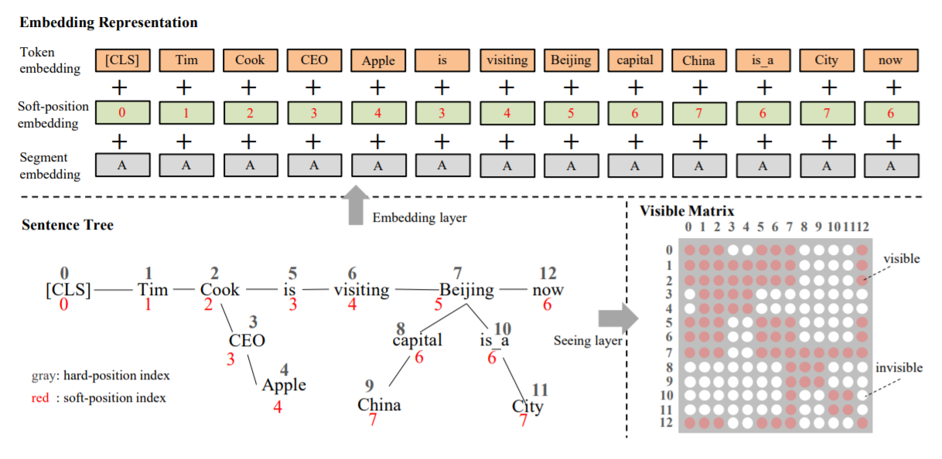
Embedding layer（EL）

Slide 21
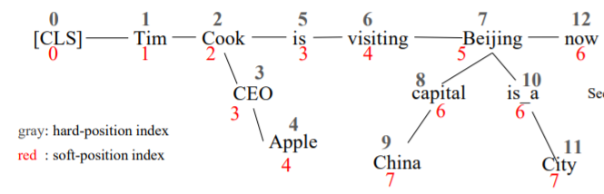
Embedding layer（EL）
1）Token embedding

Slide 22
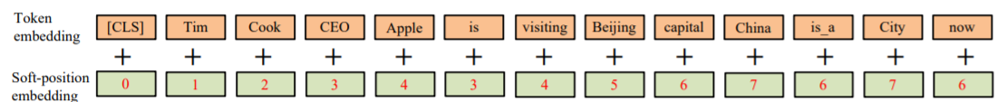
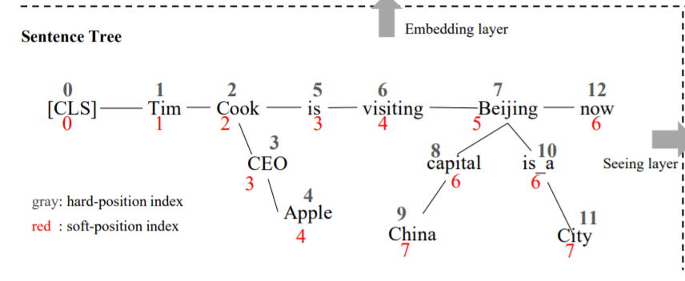
Embedding layer（EL）
2）Soft-position embedding

Slide 23
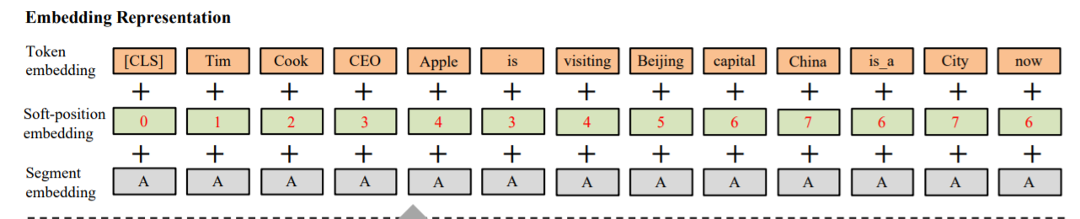
Embedding layer（EL）
3）Segment embedding

Slide 24
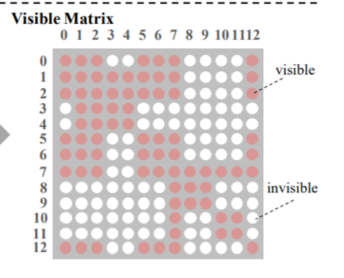
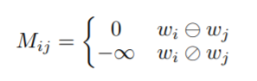
Seeing layer

Slide 25
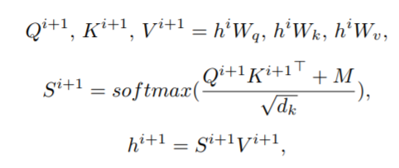
Mask-Transformer
Mask-Self-Attention

Slide 26
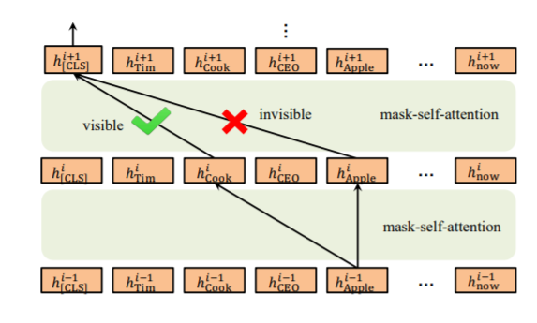
Illustration of the Mask-Transformer

Slide 27
Experiments
Pre-training corpora
WikiZh，WebtextZh
Knowledge graph
CN-DBpedia，HowNet，MedicalKG，
Baselines
Google BERT：The model was pre-trained on WikiZh and released by Google (Devlin et al. 2018).
Our BERT ：Our reimplementation of BERT with pretraining on WikiZh and WebtextZh.

Slide 28
Experiments
Open-domain tasks
Book review，Chnsenticorp，Shopping，Weibo
XNLI，LCQMC，NLPCC-DBQA，MSRA-NER
Specific-domain tasks
Domain Q&A（Finance Q&A and Law Q&A），Domain NER Finance NER，Medicine NER

Slide 29
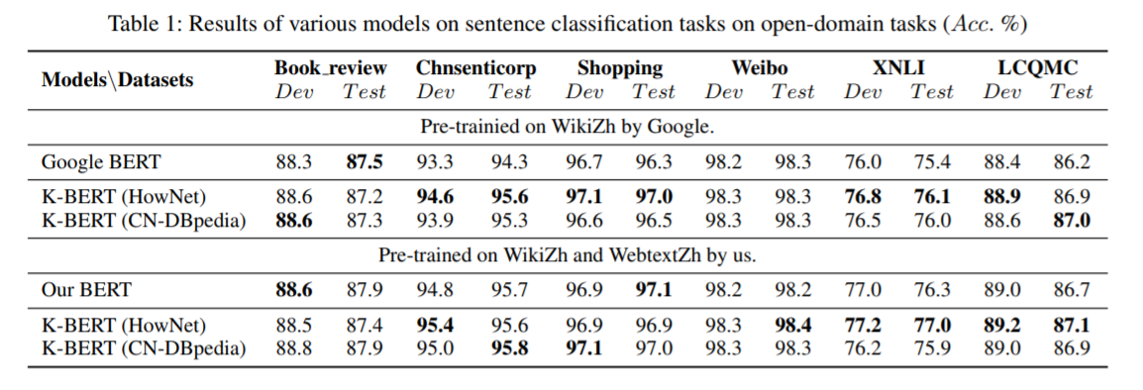
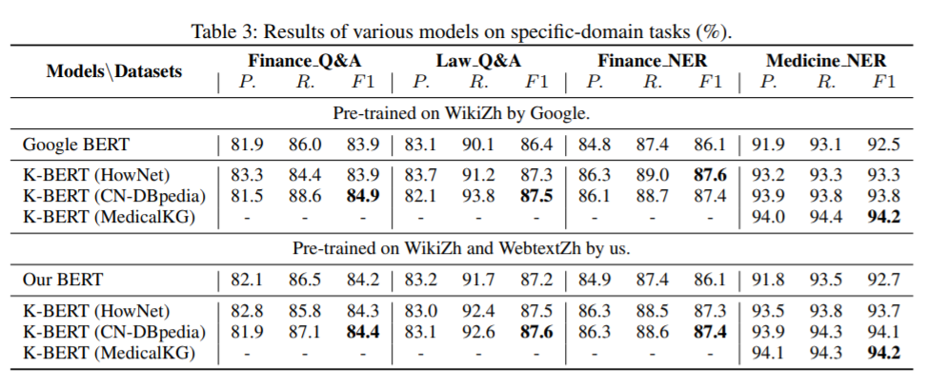

Slide 30
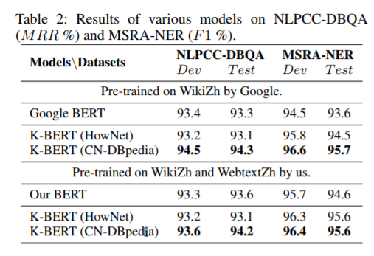
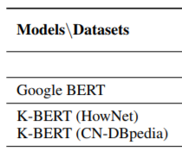
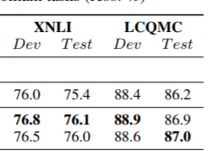

Slide 31
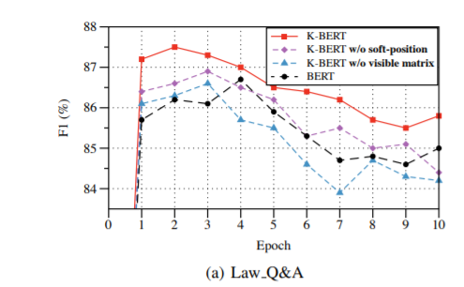
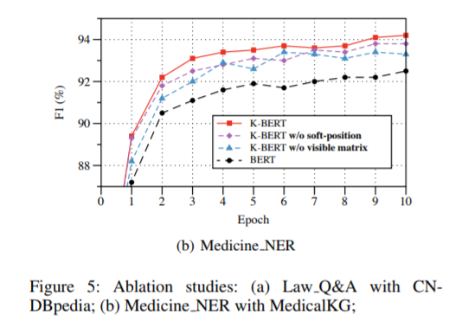
Ablation studies

Slide 32
谢谢！

